Slide 1

C♯ Data Access and Entity Framework Core
Rasmus Lystrøm
Associate Professor
ITU
This Photo by Unknown Author is licensed under CC BY-NC

Slide 2

Agenda
Databases
Old school SQL in C♯
Package managers
Secrets
The IDisposable interface
SQL Injection
Object Relational Mapping
Entity Framework Core
Clean Onions
Lazy vs. Eager Loading
This Photo by Unknown Author is licensed under CC BY-NC-ND

Slide 3
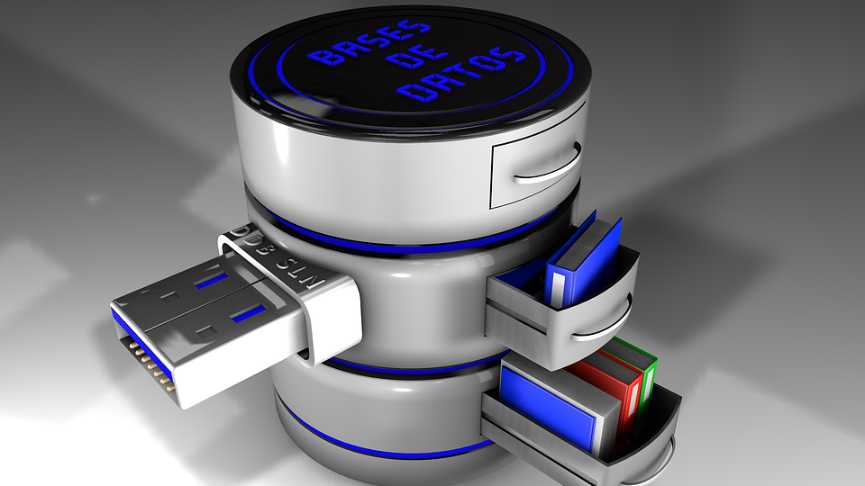
Databases

Slide 4


Databases
Microsoft SQL Server
Oracle Database
IBM Db2
MySQL
MariaDB
PostgreSQL
SQLite
Azure Cosmos DB
Amazon DynamoDB
MongoDB
Couchbase
Redis
Elasticsearch
Neo4j
This Photo by Unknown Author is licensed under CC BY-SA-NC
This Photo by Unknown Author is licensed under CC BY-SA

Slide 5
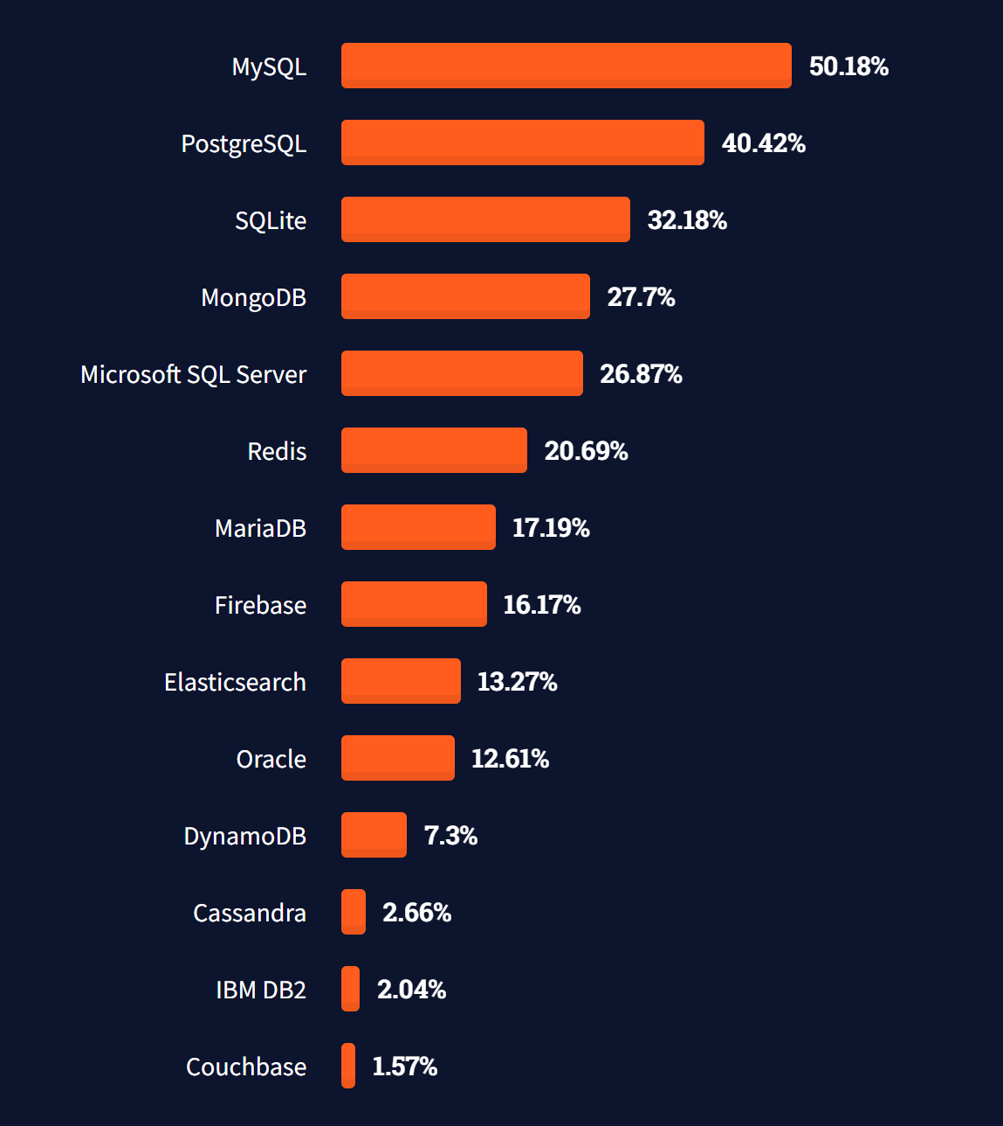
Most popular databases
https://insights.stackoverflow.com/survey/2021#technology-most-popular-technologies

Slide 6
SQL Server
docker pull mcr.microsoft.com/mssql/server:2019-latest
$password = New-Guid
docker run -e "ACCEPT_EULA=Y" -e "SA_PASSWORD=$password" `
-p 1433:1433 `
-d mcr.microsoft.com/mssql/server:2019-latest

Slide 7
SQL Server Demo
SQL Server Docker Container

Slide 8
Old School SQL
dotnet add package System.Data.SqlClient
var cmdText = "SELECT * FROM Animals";
using var connection = new SqlConnection(connectionString);
connection.Open();
using var command = new SqlCommand(cmdText, connection);
using var reader = command.ExecuteReader();
while (reader.Read())
{
...
}

Slide 9
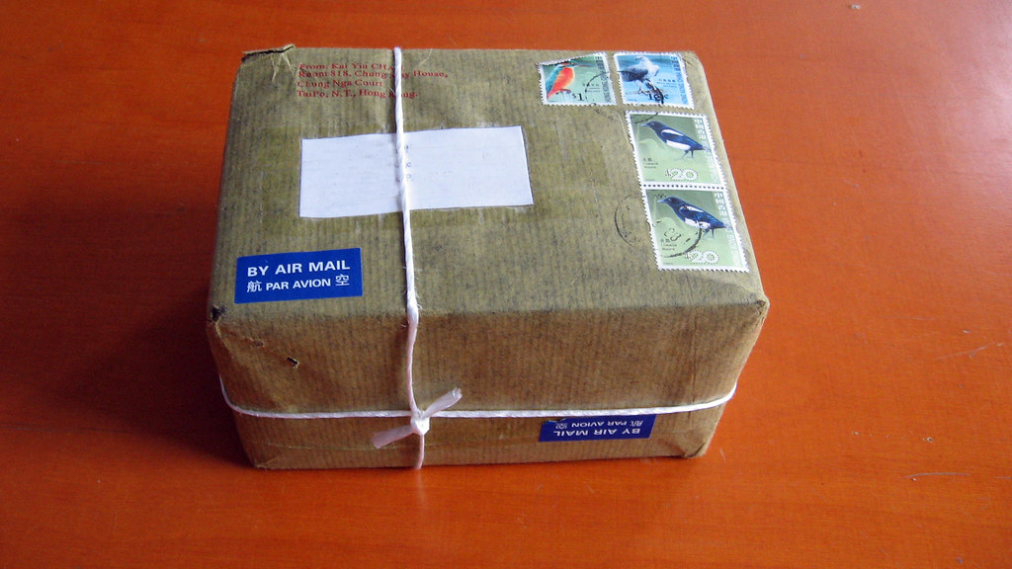
Package Manager
This Photo by Unknown Author is licensed under CC BY-SA

Slide 10
NuGet Package Manager
Source: https://www.nuget.org/
dotnet add package …
Criteria:
Downloads
License
Dependencies
Update frequency
Check source repository

Slide 11

Secrets

Slide 12
Secrets
dotnet user-secrets init
dotnet user-secrets set "ConnectionStrings:ConnectionString" "..."
dotnet add package Microsoft.Extensions.Configuration.UserSecrets

Slide 13
Secrets
using Microsoft.Extensions.Configuration;
...
var configuration = new ConfigurationBuilder()
.AddUserSecrets<Program>()
.Build();
var connectionString = configuration.GetConnectionString("ConnectionString");

Slide 14
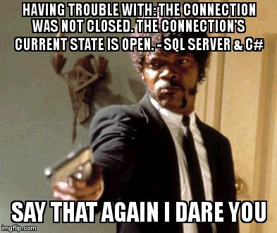
https://twitter.com/overflow_meme/status/1223835574848630784

Slide 15

IDisposable
This Photo by Unknown Author is licensed under CC BY

Slide 16
IDisposable
var resource = new Resource();
try
{
...
}
finally
{
if (resource != null)
{
resource.Dispose();
}
}

Slide 17
IDisposable II
var resource = new Resource();
try
{
...
}
finally
{
resource?.Dispose();
}

Slide 18
IDisposable III
using (var resource = new Resource())
{
...
}

Slide 19
IDisposable IV
using var resource = new Resource();
...

Slide 20

SQL Injection
This Photo by Unknown Author is licensed under CC BY

Slide 21
SQL Injection
A SQL injection attack consists of insertion or “injection” of a SQL query via the input data from the client to the application.
A successful SQL injection exploit can:
read sensitive data from the database,
modify database data (Insert/Update/Delete),
execute administration operations on the database (such as shutdown the DBMS),
or worse
https://owasp.org/www-community/attacks/SQL_Injection

Slide 22
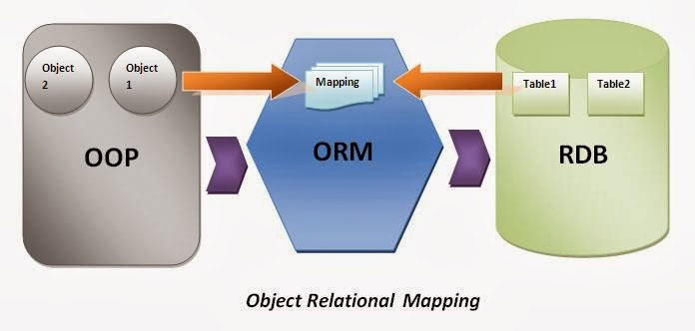
Object Relational Mapping
This Photo by Unknown Author is licensed under CC BY

Slide 23
Object Relational Mapping
The act of converting incompatible types in OOP to tables/columns/rows/relations in SQL
Object–relational impedance mismatch
- Me not understand object me table

Slide 24
Model
Character
Id : int
GivenName : string (50)
Surname : string (50)
AlterEgo : string (50)
FirstAppearance : Date
Occupation : string (50)
CityId : int
Gender : enum
City
Id : int
Name : string (50)
0..1
1
∞
Power
Id : int
Name : string (50)
∞

Slide 25

Entity Framework Core
This Photo by Unknown Author is licensed under CC BY-NC-ND

Slide 26
Entity Framework Core
dotnet tool install --global dotnet-ef
dotnet add package Microsoft.EntityFrameworkCore.Design
dotnet ef migrations add InitialCreate
dotnet ef database update
https://docs.microsoft.com/en-us/ef/core/miscellaneous/cli/dotnet
https://docs.microsoft.com/en-us/ef/core/modeling/

Slide 27

Onion Architecture

Slide 28
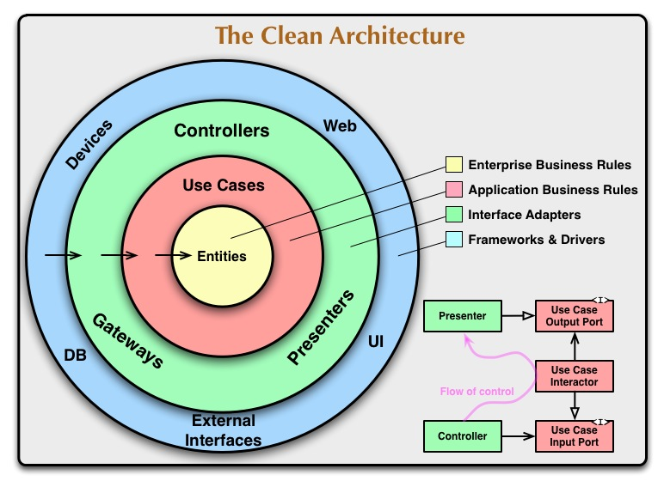

Slide 29
Lazy Loading
https://docs.microsoft.com/en-us/ef/core/querying/related-data/lazy

Slide 30
Lazy Loading
dotnet add package Microsoft.EntityFrameworkCore.Proxies
protected override void OnConfiguring(DbContextOptionsBuilder optionsBuilder)
=> optionsBuilder.UseLazyLoadingProxies()
.UseSqlServer(...);
https://docs.microsoft.com/en-us/ef/core/querying/related-data/

Slide 31

Thank you
This Photo by Unknown Author is licensed under CC BY-NC-ND

